Slide 1

The Basic Gain Cell
The CS and CE amplifier with current-source loads
Active-load CS amplifier (biased to operate in the saturation region):
Equivalent circuit
Intrinsic gain
Intrinsic gain is only 20 to 40 V/V for a MOSFET in a modern short-channel technology
For a given technology: larger A₀ as V_{OV} decreases and L increases
For a given transistor: larger A₀ increases as V_{OV} and I_{D} decrease
Gain levels off at very low currents as the MOSFET enters the subthreshold region operation where it becomes similar to a BJT with an exponential current-voltage characteristics
Notes:
V_{A} = Early voltage; thermal voltage V_{T};
V’_{A} is the technology-dependent component of the Early voltage.
V_{OV} is a design parameter, is still about 0.15 V to 0.3 V.
.

Slide 2
The Basic Gain Cell
Active-load CE amplifier (biased to operate in the active region):
Equivalent circuit
Intrinsic gain
Maximum gain obtainable in a CE amplifier (assuming an ideal dc current source)
Technology-determined parameter
Independent of the transistor junction area and the bias current for a given fabrication process
V_{A} ranges from 5 to 35 V for modern IC fabrication process
V_{A} ranges from 100 to 130 V for high-voltage process
Intrinsic gain ranges from 200 to 5000 V/V

Slide 3
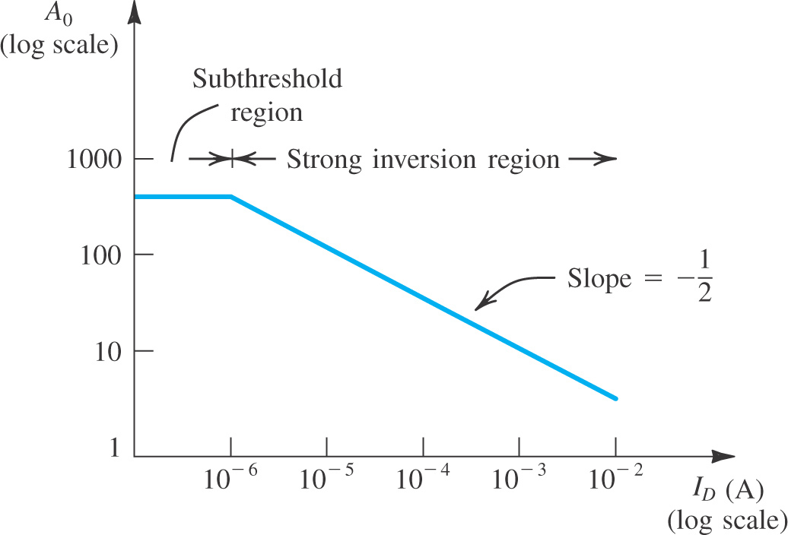

Slide 4
Example 1
We wish to compare the values of g_{m}, R_{in}, R₀, and A₀ for a CS amplifier that is designed using an NMOS transistor with L = 0.4 μm and W = 4 μm and fabricated in a 0.25-μm technology specified to have μ_{n}C_{ox} = 267 μA/V² and V’_{A} = 10V/μm, with those for a CE amplifier designed using a BJT fabricated in a process with β = 100 and V_{A} = 10 V. Assume that both devices are operating at a drain (collector) current of 100 μA.

Slide 5
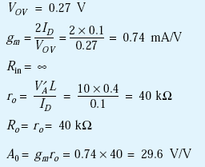
Example 1 solution
For simplicity, we shall neglect the Early effect in the MOSFET in determining V_{0V}, thus:
resulting in
For the CE amplifier we have

Slide 6
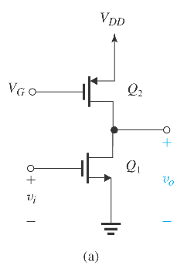
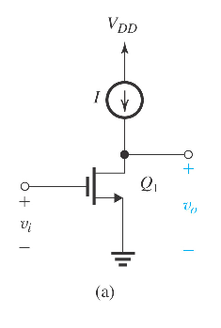
Effect of the Output Resistance of the Current-Source Load
The current source can be realized by using a PMOS in saturation
The current-source load of the CS amplifier in Figure (b) can be implemented using a PMOS transistor biased in the saturation region to provide the required current I, as shown in Figure (a).
Figure (b)
Figure (a)

Slide 7
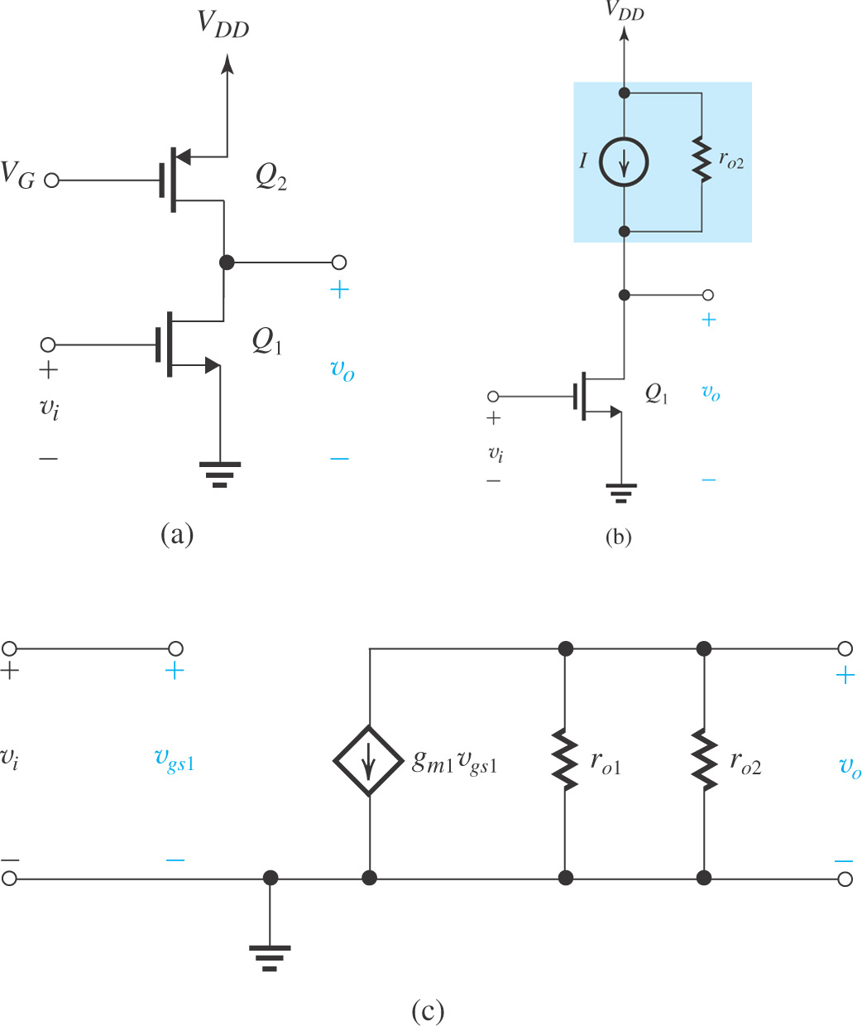
Effect of the Output Resistance of the Current-Source Load
Figure (a): The CS amplifier with the current-source load implemented with a p-channel MOSFET Q₂ ; (b) the circuit with Q₂ replaced with its large-signal model; and (c) small-signal equivalent circuit of the amplifier.

Slide 8
Effect of the Output Resistance of the Current-Source Load
The output resistance is no longer infinite due to channel-length modulation
Voltage gain of the CS amplifier with a current-source load
The voltage gain is reduced due to the finite output resistance of the current-source load.
The gain is reduced by half if Q₁ has the same Early voltage as Q₂ does (r_{o1}= r_{o2})

Slide 9
Quiz 2.2
Reuse all data given and obtained in Quiz 2.1.
Plot small signal equivalent circuit.
Determine voltage gain v_{o}/v_{i}.
Compute output impedance of the circuit.
You submit your solution not later than March 20, 2020.
You can submit through Blackboard as informed by Mr. Huy on Blackboard announcement.

